Slide 1
UNIT III
STORAGE NETWORKING TECHNOLOGIES AND VIRTUALIZATION

Slide 2
Syllabus
Block-Based Storage System - File-Based Storage System - Object-Based and Unified Storage.
Fibre Channel SAN: Software-defined networking - FC SAN components and architecture - FC SAN topologies - link aggregation - and zoning - Virtualization in FC SAN environment.
Internet Protocol SAN: iSCSI protocol - network components - and connectivity - Link aggregation - switch aggregation - and VLAN - FCIP protocol - connectivity - and configuration.
Fibre Channel over Ethernet SAN: Components of FCoE SAN - FCoE SAN connectivity - Converged Enhanced Ethernet - FCoE architecture

Slide 3
STORAGE NETWORKING
Storage networking is a dedicated high-speed network that connects servers to storage devices.
Unlike traditional storage attached directly to servers, storage networking allows multiple servers to access centralized storage.
Advantages
  Centralized storage management
  High availability
  Faster data access
  Better scalability
  Easy backup and disaster recovery
  Efficient utilization of storage resources

Slide 4
TYPES OF STORAGE SYSTEMS
There are three major storage access methods:
  Block-Based Storage
  File-Based Storage
  Object-Based Storage
Modern systems combine these into
  Unified Storage

Slide 5
BLOCK-BASED STORAGE SYSTEM
Block storage stores data as fixed-sized blocks.
Each block has a unique address but does not contain file information.
The operating system combines these blocks to create files.
Characteristics
  No file hierarchy
  Storage appears as raw disk
  High performance
  Low latency
  Used in databases
  Used in virtualization

Slide 6
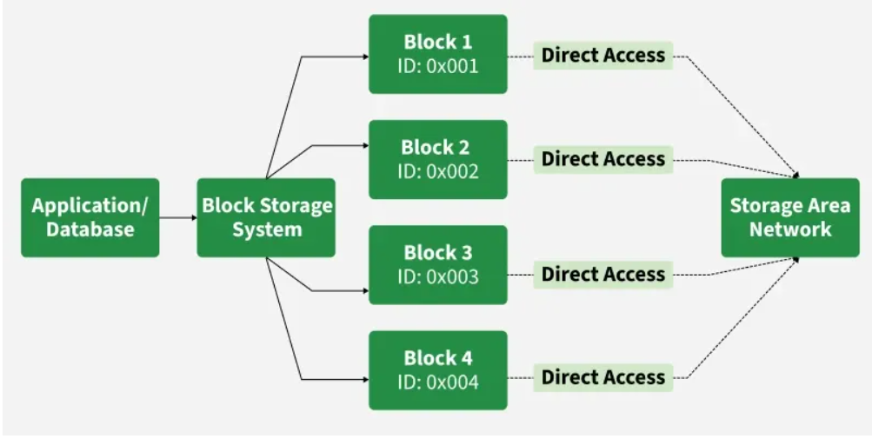
BLOCK-BASED STORAGE SYSTEM

Slide 7
BLOCK-BASED STORAGE SYSTEM
Advantages
  Very fast
  High I/O performance
  Reliable
  Supports clustering
  Suitable for mission-critical applications
Disadvantages
  Requires file system management
  Difficult to share directly
  Costlier

Slide 8
BLOCK-BASED STORAGE SYSTEM
Applications
  Oracle Database
  SQL Server
  VMware Datastores
  Hyper-V
  Banking applications
Example
  A bank database stores customer records.
  Every transaction accesses disk blocks directly.
  This provides extremely fast performance.

Slide 9
3. FILE-BASED STORAGE SYSTEM
File storage stores information in files organized into folders.
Users access files through file names instead of block addresses.
File Sharing Protocols
NFS
  Network File System
  Used mainly in Linux and UNIX.
SMB/CIFS
  Server Message Block
  Used mainly in Windows.

Slide 10
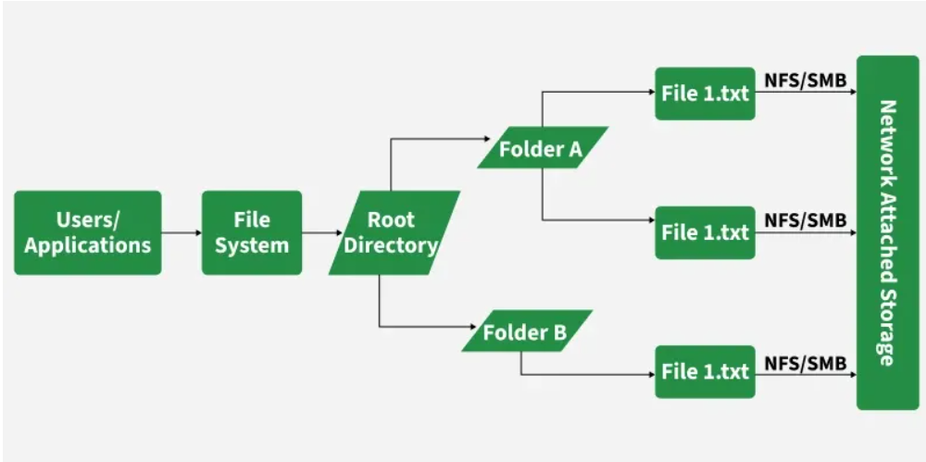
3. FILE-BASED STORAGE SYSTEM

Slide 11
3. FILE-BASED STORAGE SYSTEM
Advantages
  Easy to manage
  Easy file sharing
  Supports permissions
  Human-readable hierarchy
Disadvantages
  Slower than block storage
  Metadata overhead
  Less suitable for databases

Slide 12
3. FILE-BASED STORAGE SYSTEM
Applications
  File servers
  Home directories
  Office documents
  Shared folders
  Multimedia storage
Example
  College staff share question papers using a common network folder.
  Everyone accesses files using filenames.

Slide 13
4. OBJECT-BASED STORAGE
Definition
  Object storage stores information as independent objects.
  Each object contains
  Data
  Metadata
  Unique Object ID
Characteristics
  No folders required
  Flat namespace
  Massive scalability
  Rich metadata

Slide 14
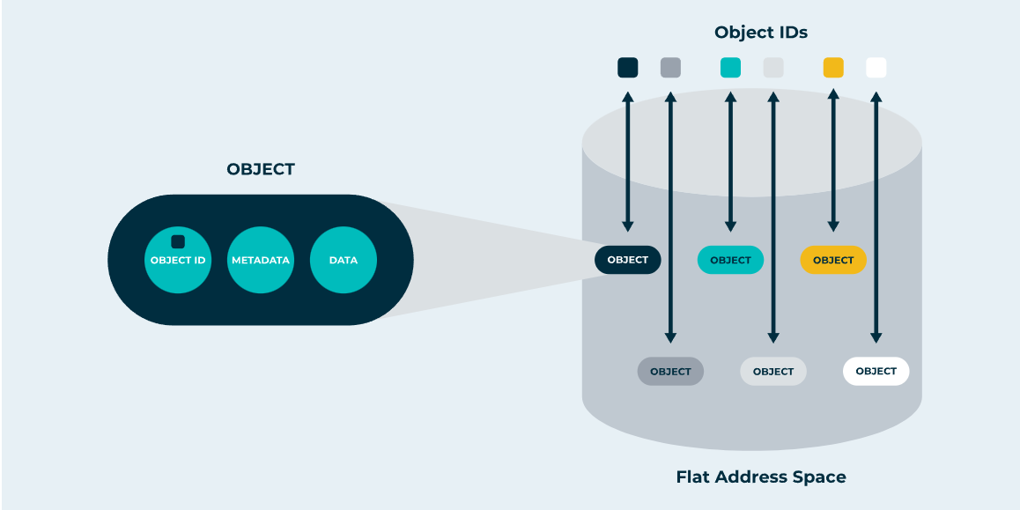
4. OBJECT-BASED STORAGE

Slide 15
4. OBJECT-BASED STORAGE
Advantages
  Unlimited scalability
  Cost-effective
  Cloud ready
  Highly durable
Disadvantages
  Higher latency
  Not suitable for databases
  Cannot be mounted as normal disk

Slide 16
4. OBJECT-BASED STORAGE
Applications
  Cloud storage
  Backup archives
  Video streaming
  AI datasets
  IoT data
Examples
  Amazon S3
  OpenStack Swift
  MinIO

Slide 17
5. UNIFIED STORAGE
Unified Storage supports both
  Block Storage
  File Storage
using a single storage array.
Benefits
  Single management interface, Reduced hardware cost
  Better storage utilization and Easy scalability
Applications
  Universities, Hospitals, Enterprises, Cloud environments

Slide 18
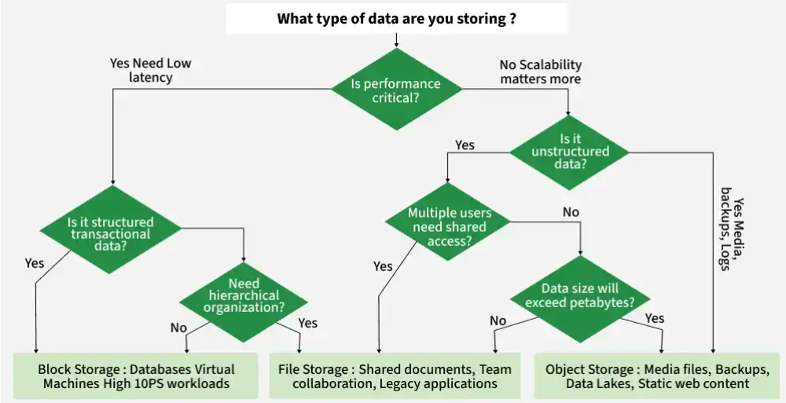
Block Storage Vs Object Storage Vs File Storage

Slide 19
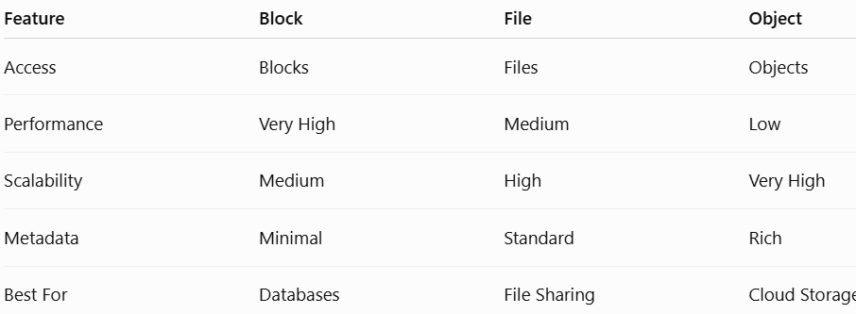
Comparison of Storage Systems

Slide 20
Comparison of Storage Systems
Block Storage | Object Storage | File Storage
Divides data into fixed-size blocks, each with a unique identifier. | Stores data as objects with metadata and a unique ID in a flat structure. | Organizes data in a hierarchical structure of files and folders.
Ideal for databases, virtual machines, and transactional workloads requiring high performance. | Best for storing large amounts of unstructured data, like multimedia files or backups. | Suitable for structured file storage and shared file access, such as documents and spreadsheets.
High performance and low latency, especially for read/write operations. | Optimised for scalability and durability, not real-time performance. | Moderate performance; dependent on file system and storage device.

Slide 21
Block Storage | Object Storage | File Storage
Scales well but may require manual configuration for capacity expansion. | Highly scalable; can handle massive amounts of data across distributed systems. | Limited scalability compared to object storage; suitable for smaller systems.
Minimal metadata, often handled by the application layer. | Extensive metadata stored with each object, enabling advanced search and analytics. | Basic metadata, such as file name, type, and permissions.
Requires manual backup or snapshot configurations for data durability. | Highly durable with built-in redundancy across multiple locations. | Data durability depends on the underlying file system and backup strategies.
AWS EBS, Google Persistent Disks, SAN (Storage Area Network). | AWS S3, Azure Blob Storage, Google Cloud Storage. | Network Attached Storage (NAS), Shared Drives, Local File Systems.

Slide 22
Fibre Channel SAN
Introduction to Fibre Channel SAN
A Storage Area Network (SAN) is a dedicated high-speed network that provides block-level access to storage devices such as disk arrays, SSDs, and tape libraries.
Unlike a traditional LAN, which mainly connects users and applications to servers, a SAN connects:
  Servers → SAN switches → Storage systems
  The server sees SAN storage as if it were a locally attached disk.
Example
Consider a company with 100 application servers and a large storage array.
Instead of connecting every server directly to the storage system:

Slide 23
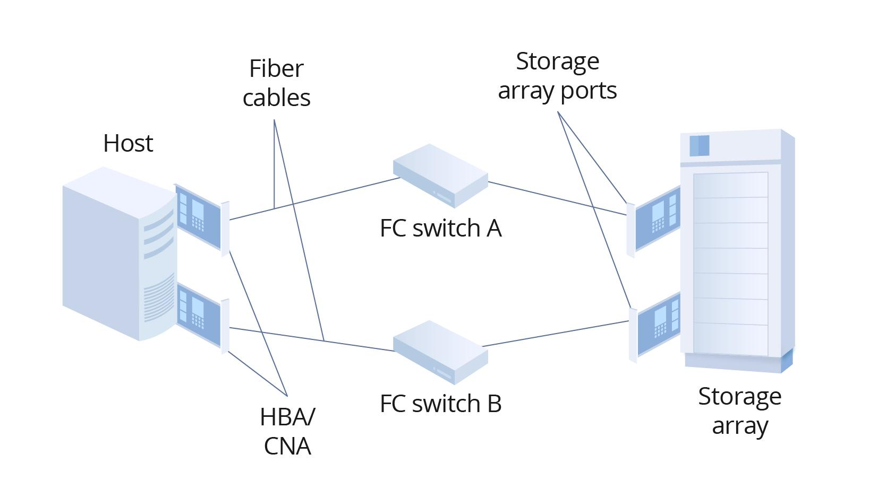
FC Switch

Slide 24
2. What is Fibre Channel?
Fibre Channel (FC) is a high-speed networking technology designed primarily for transporting storage traffic.
It is widely used to implement SANs because it provides:
  High bandwidth
  Low latency
  High reliability
  Deterministic performance
  Low error rates
  Support for long-distance connectivity
  Dedicated storage networking
  Multiple communication protocols

Slide 25
2. What is Fibre Channel?
Although the name contains "Fibre", Fibre Channel can operate over:
  Optical fibre
  Copper cables
Important Point
  Fibre Channel is not the same as Fibre Optic.
  Fibre Channel is a networking protocol and technology, whereas fibre optic is a physical transmission medium.

Slide 26
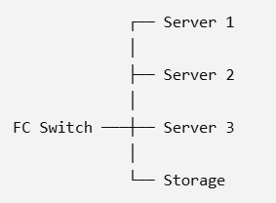
3. Why Fibre Channel is Used in SAN?
Traditional storage connectivity has limitations.
For example:
Direct-Attached Storage (DAS)
Server ───── Storage
Only a limited number of servers can directly access the storage.
With FC SAN:
Multiple servers can access centralized storage.

Slide 27
2. Software-Defined Networking (SDN)
Software-Defined Networking (SDN) is a networking approach where the control of the network is separated from the hardware that forwards data.
Normally, a network switch decides where packets should go.
In SDN:
SDN Controller → controls → Network Switches
Two important planes
1. Control Plane
Decides where the data should go.
Managed centrally by the SDN controller.
2. Data Plane
Actually forwards the data.
Implemented by switches/routers.

Slide 28
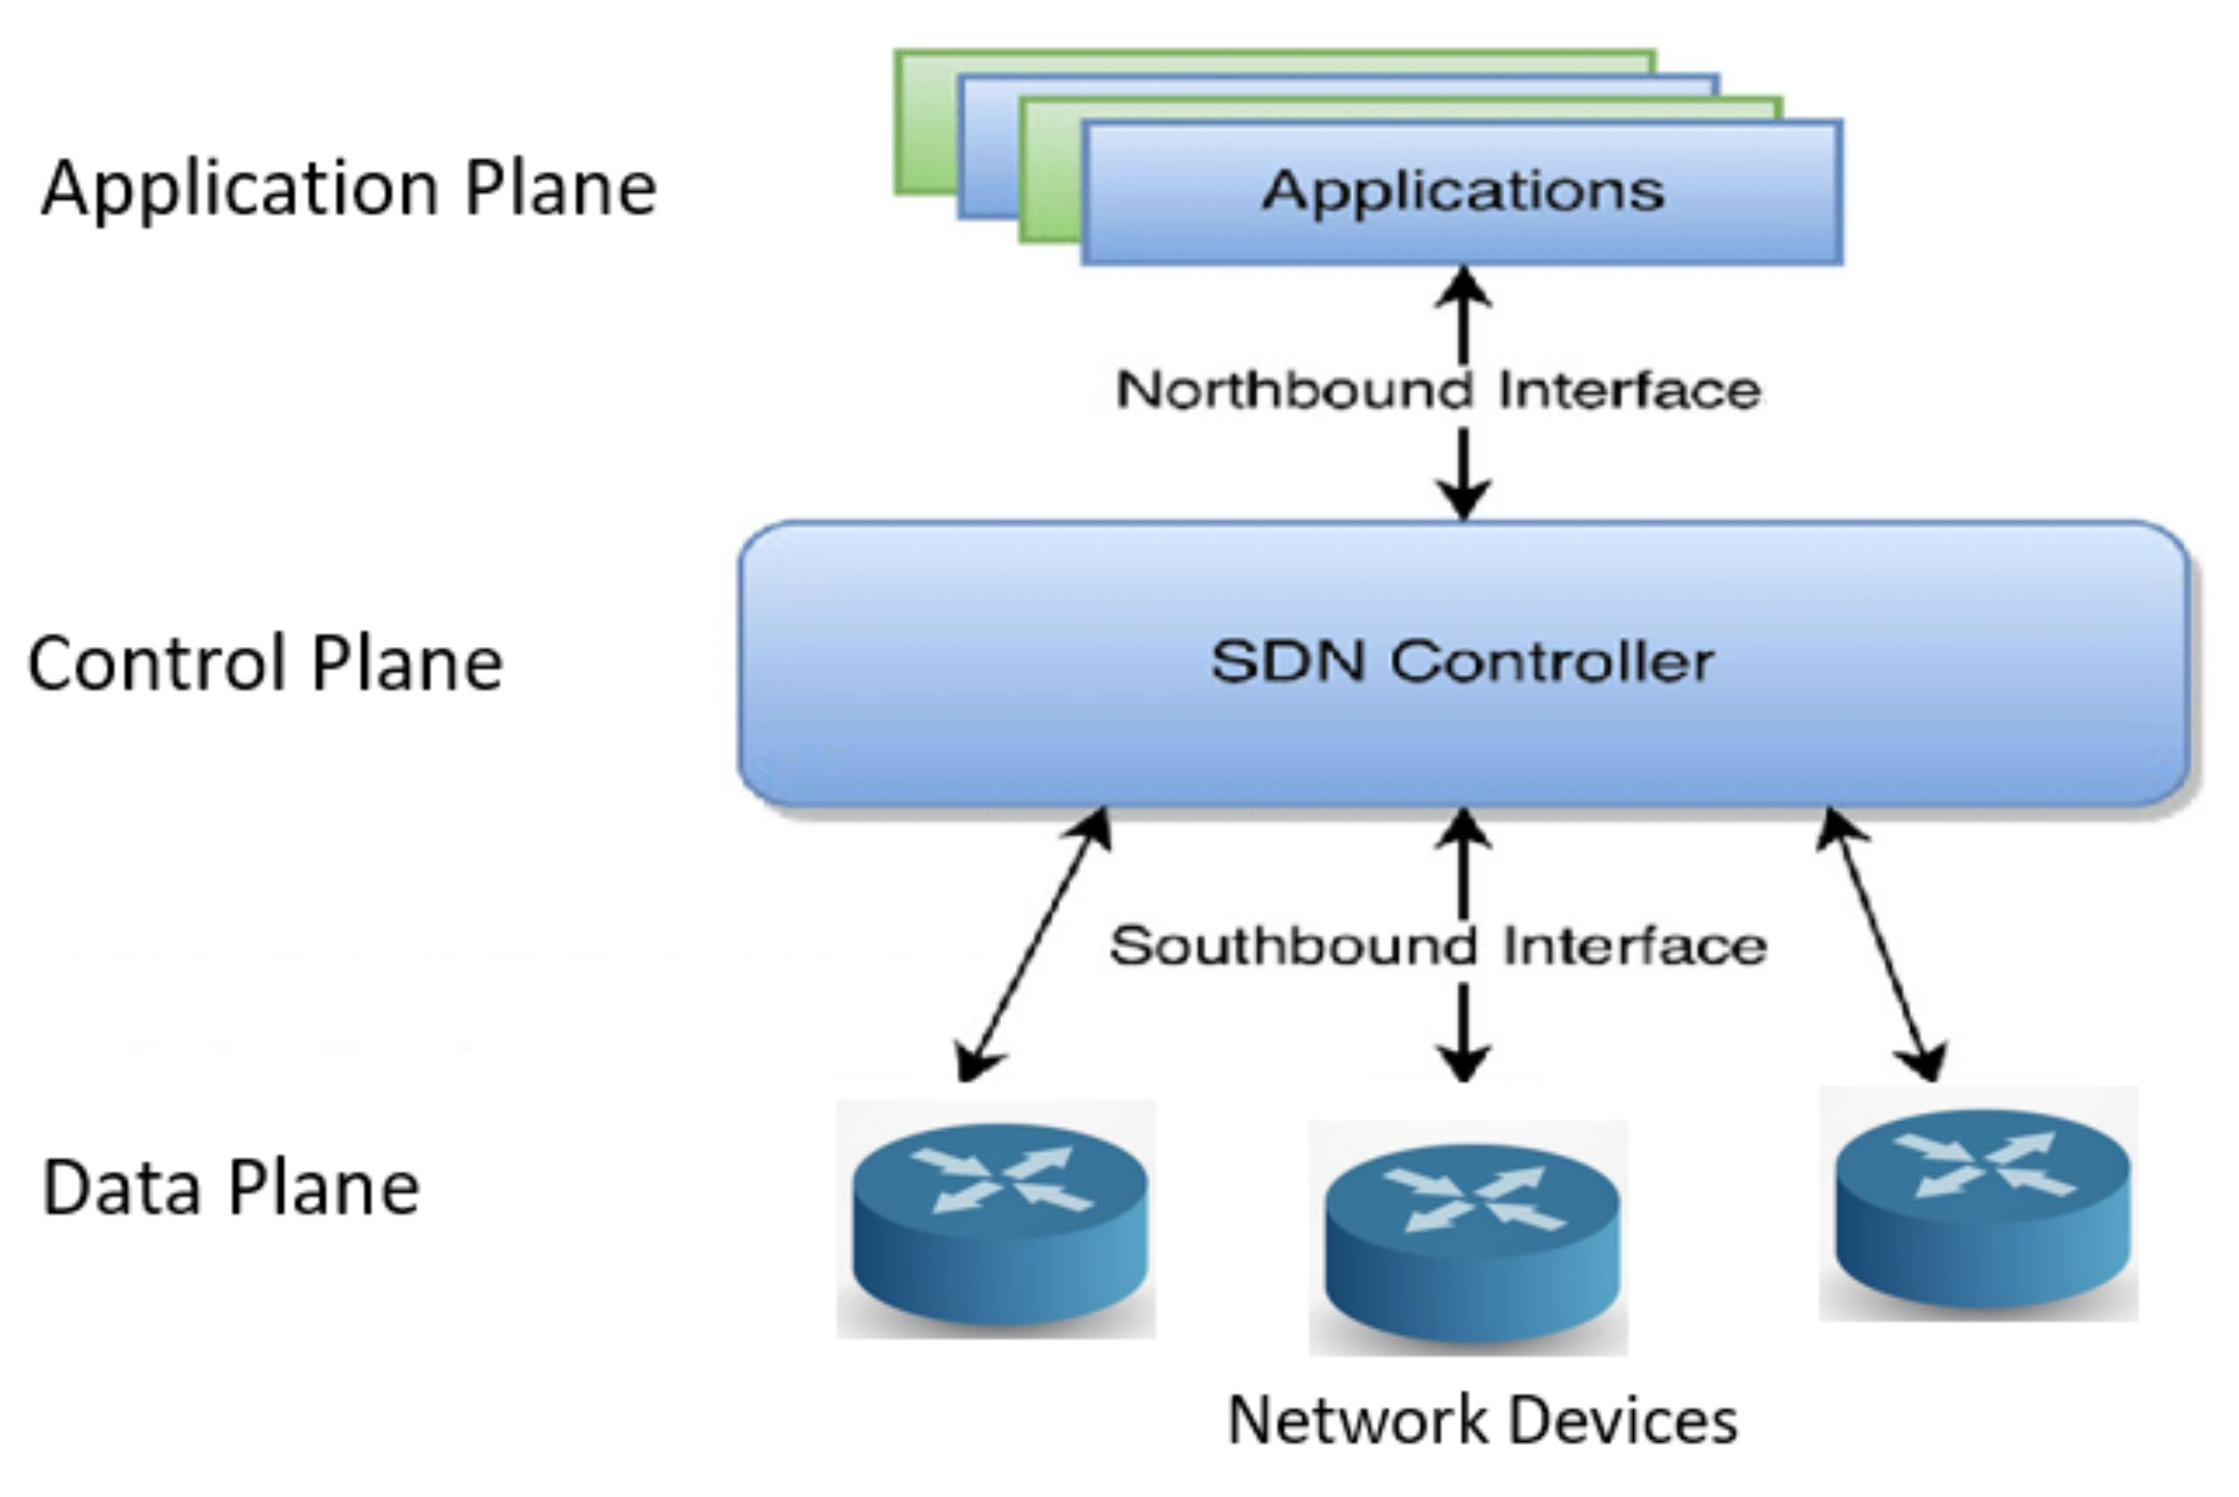
SDN

Slide 29
Software-Defined Networking (SDN)
Simple example
Imagine a traffic police control room:
  Control room = SDN Controller
  Roads = Network
  Traffic signals = Switches
  Vehicles = Data packets
The control room decides how traffic should flow, while the signals and roads handle the actual movement.

Slide 30
FC SAN Components
The major components of an FC SAN are:
1. Host / Server
The server that needs access to storage.
Examples:
Database servers , Application servers , Web servers , Virtualization servers, Backup servers
The host runs an operating system such as:
Windows Server, Linux , VMware ESXi, Unix
The host does not normally connect directly to the FC cable. It requires an HBA.

Slide 31
2. HBA – Host Bus Adapter
A Host Bus Adapter (HBA) is a hardware interface installed in a server that provides connectivity between the server and the Fibre Channel SAN.
It is similar in concept to a network interface card (NIC), but it is designed specifically for storage connectivity.
NIC | HBA
Connects server to LAN | Connects server to SAN
Carries network traffic | Carries storage traffic
Uses Ethernet | Uses Fibre Channel
Usually identified by MAC address | FC devices have WWNs

Slide 32
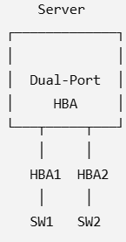
Functions of HBA
The HBA:
  Connects the server to FC fabric.
  Converts server I/O requests into Fibre Channel frames.
  Receives Fibre Channel frames from the SAN.
  Provides FC port identification.
  Supports high-speed data transfer.
  Offloads some storage processing from the CPU.
Dual-port HBA
  Servers commonly use dual-port HBAs for redundancy.
  If one path fails, the other path can continue carrying storage traffic.

Slide 33

3. FC Switch
The FC switch is one of the most important components of an FC SAN.
It connects:
  Servers
  Storage arrays
  Other FC switches
  and creates the Fibre Channel fabric.
Functions of an FC switch
The switch:
  Connects FC devices.
  Creates communication paths.
  Forwards FC frames.
  Maintains fabric information.
  Supports zoning.
  Provides high-speed switching.
  Supports multiple simultaneous connections.
  Provides redundancy when multiple switches are deployed.

Slide 34
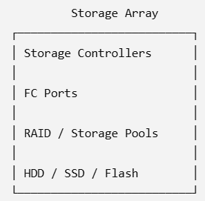
4. Storage Array
A storage array is a centralized storage system that provides storage capacity to multiple servers.
Examples of storage resources include:
  HDDs
  SSDs
  Flash drives
  RAID groups
  Storage pools
A storage array generally contains:

Slide 35
5. Fibre Channel Ports
Port | Full Form | Main Purpose
N_Port | Node Port | Connects an end device to the FC fabric
NL_Port | Node Loop Port | Connects an end device to an FC-AL loop
F_Port | Fabric Port | Connects an N_Port to an FC switch
FL_Port | Fabric Loop Port | Connects an FC-AL loop to an FC switch
E_Port | Expansion Port | Connects two FC switches
EX_Port | FC Router Expansion Port | Connects an FC switch to an FC router
TE_Port | Trunking E_Port | Provides trunking between switches
VE_Port | Virtual E_Port | Used for virtual/FCIP-based inter-switch connectivity

Slide 36
6. Fibre Channel Cables
FC SAN uses specialized physical media.
The common media are:
i) Fibre Optic Cable
Used extensively in data centers.
Advantages:
High bandwidth, Long-distance transmission,
Low electromagnetic interference, High reliability
Two common types are:
  Multimode fiber
  Single-mode fiber
ii) Copper Cable
Copper-based FC connections may be used for shorter distances, although optical fiber is common in modern SAN environments.

Slide 37
FC SAN Architecture
Point-to-point Architecture
FC-Arbitrated Loop
FC-Switch

Slide 38
Point-to-point Architecture:
In this configuration, two nodes are connected directly to each other. This configuration provides a dedicated connection for data transmission between nodes. However, the point-to-point configuration offers limited connectivity and scalability and is used in a DAS environment.

Slide 39
FC-Arbitrated Loop:
In this configuration, the devices are attached to a shared loop. Each device contends with other devices to perform I/O operations. The devices on the loop must “arbitrate” to gain control of the loop. At any given time, only one device can perform I/O operations on the loop. Because each device in a loop must wait for its turn to process an I/O request, the overall performance in FC-AL environments is low.

Slide 40
FC-Arbitrated Loop
Further, adding or removing a device results in loop re-initialization, which can cause a momentary pause in loop traffic. As a loop configuration, FC-AL can be implemented without any interconnecting devices by directly connecting one device to another two devices in a ring through cables. However, FC-AL implementations may also use FC hubs through which the arbitrated loop is physically connected in a star topology.

Slide 41
FC-Switch:
It involves a single FC switch or a network of FC switches (including FC directors) to interconnect the nodes. It is also referred to as fabric connect. A fabric is a logical space in which all nodes communicate with one another in a network. In a fabric, the link between any two switches is called an Interswitch link (ISL). ISLs enable switches to be connected together to form a single, larger fabric.

Slide 42
FC-Switch
Direct Communication:
In an FC-SW (Fibre Channel Switched Fabric), each node communicates through a dedicated path using switches. Nodes do not share a common loop.
High Scalability:
New nodes can be easily added or removed from the fabric without disturbing the communication between other nodes.
Fabric Services:
FC switches operate up to the FC-2 layer and provide important services such as Name Server, Zoning, and Time Synchronization.

Slide 43
FC-Switch
Inter-Switch Link (ISL):
When multiple FC switches are connected, they use an ISL. ISLs allow multiple switches to join together and form a single common fabric.
ISL Bonding:
Multiple ISLs can be combined into a logical ISL. This increases bandwidth, provides load balancing, and improves availability/reliability.

Slide 44
Virtualization in FC SAN Environment
1. Introduction
Virtualization in a Fibre Channel (FC) SAN environment is the technique of abstracting physical storage resources, servers, and FC connectivity so that applications can use storage without needing to know the exact physical location of the storage device.
In a traditional FC SAN, a server is connected through an HBA (Host Bus Adapter) to an FC switch, which connects it to a storage array.
With virtualization, the physical storage infrastructure is abstracted into logical resources such as:
Virtual servers, Virtual HBAs, Virtual storage volumes, Virtual ports, Virtual switches, Virtual storage pools, Virtual SANs
This improves resource utilization, flexibility, scalability, availability, and management.

Slide 45
Why Virtualization is Required in FC SAN
Large data centers may contain:
  Hundreds of physical servers
  Multiple FC switches
  Multiple storage arrays
  Thousands of LUNs
  Multiple applications
  Virtual machines
  Managing these resources individually becomes complex.

Slide 46
Virtualization provides an abstraction layer between physical infrastructure and applications.
Major objectives
Improve storage utilization
Reduce hardware dependency
Simplify management
Provide flexible resource allocation
Support server consolidation
Improve availability
Enable easier migration
Support disaster recovery
Provide isolation between environments
Reduce operational cost

Slide 47
Types of Virtualization in FC SAN
Major types
Server virtualization
Storage virtualization
FC network virtualization
Virtual HBA virtualization
Virtual SAN (VSAN)
Virtual machine storage virtualization

Slide 48
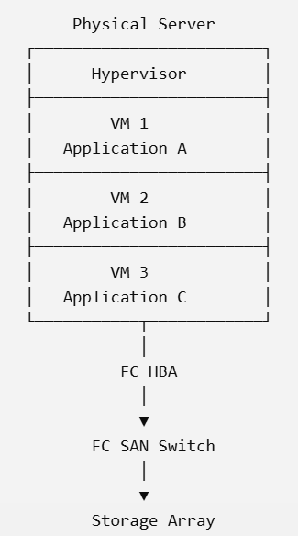
1. Server Virtualization
Server virtualization allows multiple virtual machines (VMs) to run on a single physical server.
A software layer called a hypervisor manages the virtual machines.
Examples of hypervisors include:
VMware ESXi (Elastic Sky X Integrated)
Microsoft Hyper-V
KVM (Kernel Based VM)
Instead of having three physical servers,
three virtual machines can run on one physical server.

Slide 49
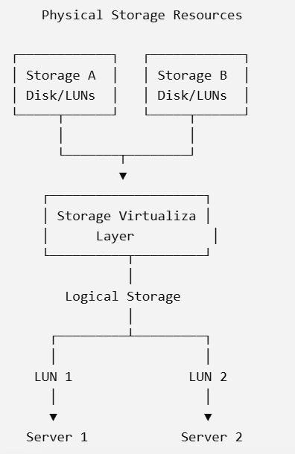
2. Storage Virtualization
Storage virtualization combines physical storage resources and presents them as logical storage resources.
The physical storage may be distributed across:
Multiple storage arrays
Multiple disks
Different storage systems
Different locations
The user sees a logical storage resource rather than
the physical disks.
The storage virtualization layer hides the physical storage details from the host.

Slide 50
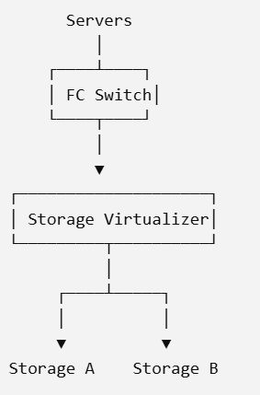
3. FC Network Virtualization
In network-based storage virtualization, a virtualization appliance or intelligent network device sits between the servers and storage systems.
The virtualization device presents virtual storage resources to hosts while managing the underlying physical storage.

Slide 51
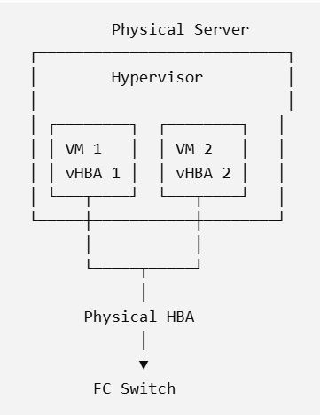
4. Virtual HBA
A physical server normally uses an HBA (Host Bus Adapter) to connect to the FC SAN.
In a virtualized server environment, a physical HBA can support multiple virtual HBAs.
A virtual HBA provides each VM with an identity that allows it to access FC storage.

Slide 52
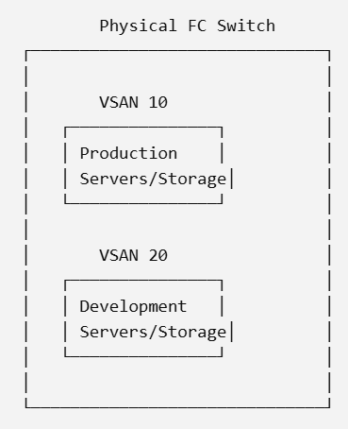
5. Virtual SAN (VSAN)
A VSAN (Virtual Storage Area Network) divides a physical FC switch or physical FC fabric into multiple logical SANs.
Each VSAN operates as an independent logical fabric.
Although VSANs share the same physical switch hardware, their traffic is logically separated.

Slide 53
End-to-End Operation
Consider a virtual machine VM1 that needs to access a database LUN.
Step 1 – VM requests storage
VM1 sends an I/O request to its virtual disk.
Step 2 – Hypervisor processes the request
The hypervisor maps the VM's virtual disk to an FC-accessible storage resource.
Step 3 – Virtual HBA identifies VM
The virtual HBA provides a virtual FC identity, generally represented using a virtual WWPN.
Step 4 – FC switch receives request
The FC switch identifies the source and destination.
Step 5 – Zoning is checked
The FC fabric verifies whether VM1 is permitted to access the destination storage port.
Step 6 – Storage array receives request
The storage array identifies the host through its WWPN.
Step 7 – LUN masking is applied
The storage system checks whether the host is authorized to access the requested LUN.
Step 8 – Data is transferred
The requested data travels back through the FC fabric to VM1.

Slide 54
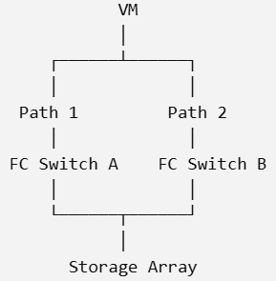
Virtualization and Multipathing
FC SANs normally use multiple paths for high availability.
For example:
If one path fails, the other path can continue carrying traffic.
This technique is called multipathing.
A software component called MPIO (Multipath I/O) or an equivalent multipathing framework manages multiple paths.
Benefits
  High availability
  Fault tolerance
  Load balancing
  Continuous access to storage

Slide 55
Example Scenario
Consider a data center with:
10 physical servers
50 virtual machines
2 FC switches
3 storage arrays
Without virtualization, managing 50 workloads individually would be difficult.

Slide 56
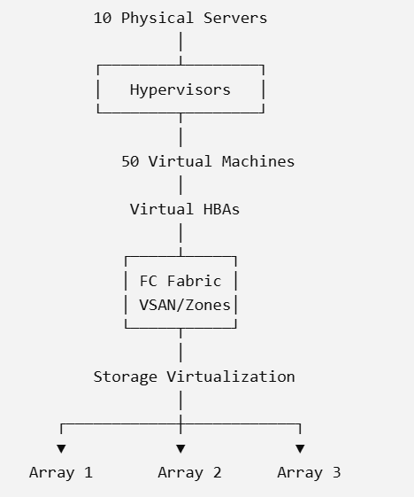
With virtualization:
The infrastructure can therefore be managed as logical resources while the physical infrastructure remains shared.

Slide 57
Internet Protocol SAN:
iSCSI protocol - network components - and connectivity - Link aggregation - switch aggregation - and VLAN - FCIP protocol - connectivity - and configuration.

Slide 58
Introduction to iSCSI Protocol
iSCSI (Internet Small Computer Systems Interface) is a storage networking protocol that allows SCSI commands to be transported over an IP network.
In simple terms:
iSCSI enables a computer to access storage devices over a standard Ethernet/IP network as if the storage were directly attached to the computer.
Traditionally, SCSI devices were connected directly to servers using SCSI cables. iSCSI removes this physical limitation by encapsulating SCSI commands and data inside TCP/IP packets.

Slide 59
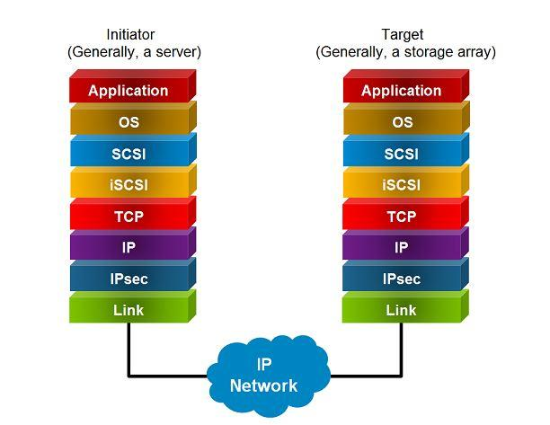

Slide 60
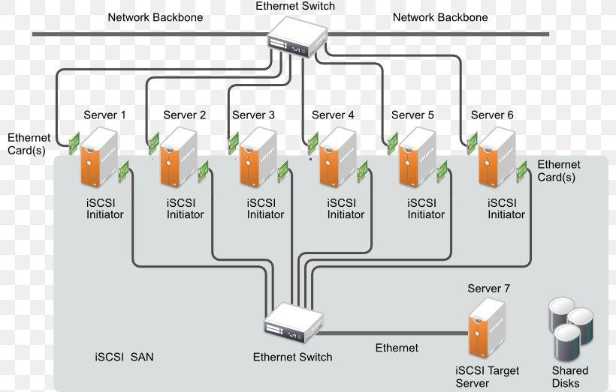
The server sends SCSI commands through the IP network to the storage system. The storage system processes the commands and returns the requested data.

Slide 61
iSCSI stands for Internet Small Computer Systems Interface.
It is an IP-based storage networking protocol that provides block-level access to storage devices over TCP/IP networks.
The important idea behind iSCSI is:
SCSI → encapsulated in iSCSI → transported using TCP → transmitted over IP/Ethernet
Thus, iSCSI combines:
SCSI – storage command set
iSCSI – encapsulation and communication protocol
TCP – reliable transport
IP – network addressing
Ethernet – commonly used physical/network infrastructure

Slide 62
Example
Suppose a server wants to read a block of data from a remote storage device.
The process is approximately:
Application
Operating System
SCSI Command
iSCSI Encapsulation
TCP
IP
Ethernet
Network
iSCSI Target
Storage Device

Slide 63
3. Why was iSCSI Developed?
Organizations traditionally used technologies such as Fibre Channel (FC) to build Storage Area Networks (SANs).
Although Fibre Channel provides high-performance storage networking, it generally requires:
  Specialized Fibre Channel switches
  Fibre Channel host bus adapters
  Fibre Channel cables
  Specialized knowledge
  Additional infrastructure and management
Many organizations already had Ethernet and TCP/IP networks.
iSCSI provides a way to use existing IP networking technologies for storage communication.

Slide 64
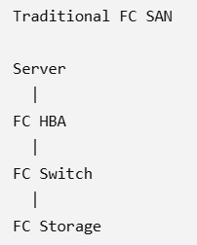
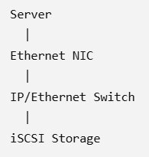
Basic idea With iSCSI:
Therefore, iSCSI can reduce the need for a separate specialized storage network.

Slide 65
4. Main Characteristics of iSCSI
4.1 IP-Based
iSCSI uses the TCP/IP protocol suite.
This means storage traffic can travel through standard IP networks.
4.2 Block-Level Storage
iSCSI provides block-level access.
The server does not access individual files directly through iSCSI. Instead, it sees a logical block device.
The operating system can format the LUN with a file system such as NTFS, ext4, XFS, etc.

Slide 66
4.3 Uses TCP
iSCSI operates over TCP.
The standard iSCSI TCP port is:
TCP port 3260
Therefore:
iSCSI
↓
TCP
↓
Port 3260

Slide 67
4.4 Uses Standard Ethernet
iSCSI can use standard Ethernet infrastructure.
For example:
1 Gb Ethernet
10 Gb Ethernet
25 Gb Ethernet
40 Gb Ethernet
100 Gb Ethernet
depending on the network and storage equipment.

Slide 68
4.5 Remote Storage Access
The storage device does not have to be physically located beside the server.
For example:
Server Room A
|
| IP Network
|
↓
Storage Room B
The server can access storage located elsewhere in the data center or network.

Slide 69
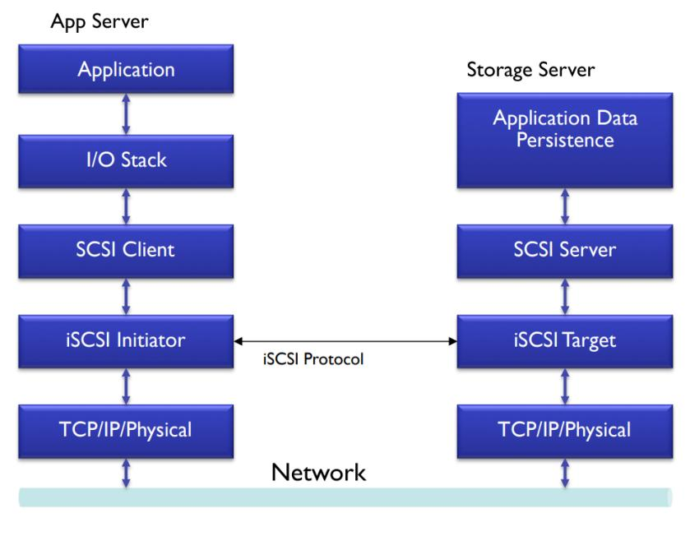
iSCSI Architecture
The basic iSCSI architecture contains two important endpoints:
  iSCSI Initiator
  iSCSI Target

Slide 70
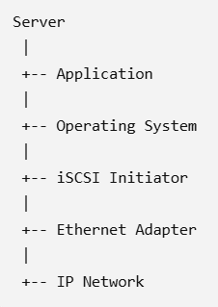
iSCSI Initiator
An iSCSI initiator is the system or software component that starts an iSCSI communication session.
Usually, the initiator is located on the server.
Responsibilities
The initiator:
  Initiates communication with the target.
  Sends SCSI commands.
  Encapsulates SCSI commands into iSCSI messages.
  Sends the messages through TCP/IP.
  Receives responses from the target.
  Provides access to remote storage for the operating system.
Example
A Windows or Linux server can contain an iSCSI initiator.

Slide 71
iSCSI Target
An iSCSI target is the storage-side endpoint that receives requests from the initiator.
It is normally implemented in:
  Storage arrays
  NAS appliances with iSCSI support
  Dedicated storage servers
  Virtualization platforms
  Linux/Windows storage servers
The target provides storage resources to initiators.

Slide 72
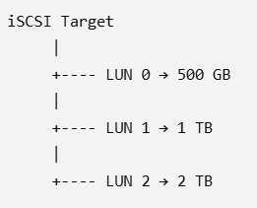
LUN — Logical Unit Number
A LUN (Logical Unit Number) identifies a logical storage unit presented by an iSCSI target.
For example:
A server may connect to a target and discover one or more LUNs.
The operating system can then recognize the LUN as a disk.
  Important distinction
  Target = storage endpoint
  LUN = storage resource presented by the target

Slide 73
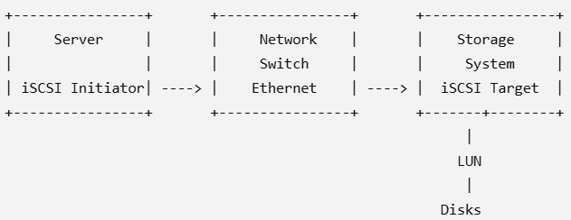
iSCSI Network Components and Connectivity
1. Introduction
iSCSI (Internet Small Computer Systems Interface) allows a server to access storage through a normal IP/Ethernet network.
In simple words:
iSCSI connects a server to remote storage using an Ethernet network.
A basic iSCSI connection looks like this:

Slide 74
2. Main Network Components of iSCSI
The important components are:
  iSCSI Initiator
  iSCSI Target
  Network Interface Card (NIC)
  Ethernet Switch
  IP Network
  Storage System
  LUN
  Cables

Slide 75
3. iSCSI Initiator
The initiator is the component that requests or accesses storage.
It is normally present on the server.
The initiator sends storage requests to the iSCSI target.
Functions
  Starts communication with the target.
  Sends SCSI commands.
  Receives data from storage.
  Provides access to remote LUNs.
Easy way to remember
Initiator = Server side = Requests storage

Slide 76
4. iSCSI Target
The target is the storage-side component that provides storage to the initiator.
It is normally available on a storage array or storage server.
Functions
  Receives requests from the initiator.
  Processes SCSI commands.
  Provides LUNs to the server.
  Sends requested data back to the initiator.
Easy way to remember
Target = Storage side = Provides storage

Slide 77
5. Network Interface Card (NIC)
A NIC (Network Interface Card) allows the server or storage system to connect to the Ethernet network.
iSCSI commonly uses Ethernet NICs for communication.
Modern systems may use high-speed Ethernet such as:
10 GbE
25 GbE
40 GbE
100 GbE
depending on the environment.

Slide 78
6. Ethernet Switch
The Ethernet switch connects the server and storage system.
The switch forwards iSCSI traffic between the initiator and target.
Functions
  Connects servers and storage.
  Forwards Ethernet frames.
  Provides network connectivity.
  Can support VLANs and link aggregation.

Slide 79
7. IP Network
iSCSI uses the TCP/IP network to transfer storage traffic.
The server communicates with the storage using IP addresses.
8. TCP
iSCSI uses TCP (Transmission Control Protocol) for reliable communication.
The standard iSCSI TCP port is:
TCP Port 3260
TCP ensures reliable delivery of data between the initiator and target.

Slide 80
9. Storage System
The storage system contains the actual physical storage resources.
It may contain:
  HDDs
  SSDs
  RAID groups
  Storage pools
  Cache
  Controllers
The storage system presents logical storage to servers through iSCSI.

Slide 81
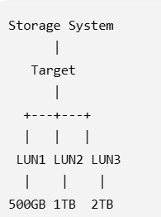
10. LUN
LUN = Logical Unit Number
A LUN is a logical storage unit provided by the iSCSI target.
For example:
The server sees the LUN as a disk.
LUN = Storage space given to the server

